Slide 1
Non-Functional Requirements
CSE 478 (Fall 2011)

Slide 2
Table of Contents
Non-Functional Requirements and Software Quality Attributes
  Software Quality
  Classifications of Non-Functional Requirements
  Quality Measures
To measure is to know. If you can not measure it, you can not improve it.¹
[1] Lord Kelvin (1824 - 1907)

Slide 3
Software Quality (1)
Introduction to Requirements Specification Software Quality Classifications of NFRs Quality Measures
Most definitions require compliance with requirements
Implication:
  We need to be able to explicitly quantify requirements and verify that any solution meets them
Measurable objectives are usually achieved!
Therefore, unless you have unrealistic values, requirements are usually met
Important to know what measures exist!

Slide 4
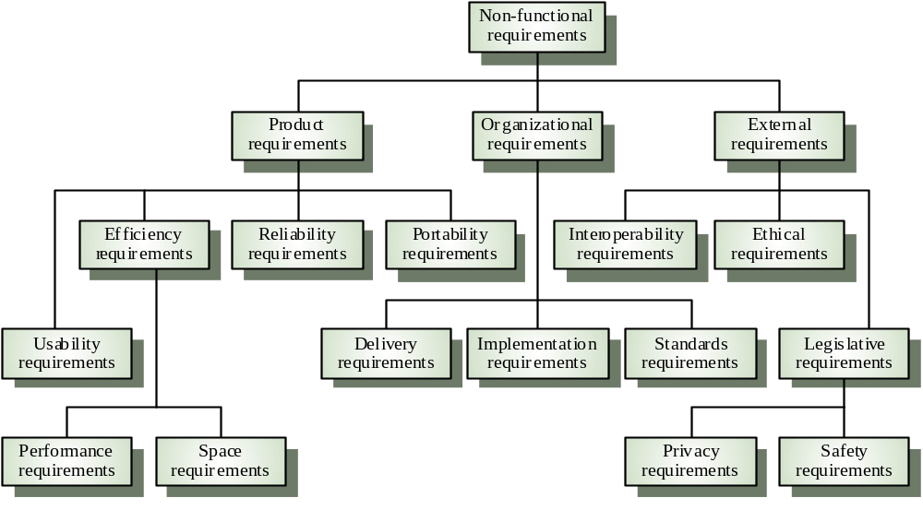
Types of Non-Functional Requirements (NFRs)
Introduction to Requirements Specification Software Quality Classifications of NFRs Quality Measures
Source: Gerald Kotonya and Ian Sommerville, Requirements Engineering – Processes and Techniques, Wiley, 1998

Slide 5
Other Classification of NFRs (1)
Introduction to Requirements Specification Software Quality Classifications of NFRs Quality Measures
Product-oriented attributes
  Performance : (a) response time, (b) throughput (number of operations performed per second)
  Usability: effort required to learn, use, provide input and interpret results of a program
  Efficiency: minimal use of resources (memory, processor, disk, network…)
  Reliability: of computations, precision
  Robustness: in the presence of faults, stress, invalid inputs…
  Adaptability: to other environments or problems
  Scalability: for large number of users or quantities of data
  Cost: total cost of ownership (TCO) for acquisition, installation, use, disposal

Slide 6
Other Classification of NFRs (2)
Introduction to Requirements Specification Software Quality Classifications of NFRs Quality Measures
Product family-oriented attributes
  Portability: does it work for several platforms
  Modifiability: addition of new functionalities
  Reusability: of components, code, designs, and even requirements in other systems
  They are frequently demanded by developers to:
    Reduce development costs
    Increase revenues by creating several versions derived from a product or by personalizing it

Slide 7
Other Classification of NFRs (3)
Introduction to Requirements Specification Software Quality Classifications of NFRs Quality Measures
Process-oriented attributes
  Maintainability: changes to functionalities, repairs
  Readability: of code, documents
  Testability: ease of testing and error reporting
  Understandability: of design, architecture, code
  Integrability: ability to integrate components
  Complexity: degree of dependency and interaction between components

Slide 8
Quantification
Introduction to Requirements Specification Software Quality Classifications of NFRs Quality Measures
Non-functional requirements need to be measurable
  Avoid subjective characterization: good, optimal, better...
Values are not just randomly specified
  Must have a rationale
  Stakeholder must understand trade-offs
  Important to rank and prioritize the requirements
Precise numbers are unlikely to be known at the beginning of the requirement process
  Do not slow down your initial elicitation process
  Ensure that quality attributes are identified
  Negotiate precise values later during the process

Slide 9
Performance Measures (1)
Introduction to Requirements Specification Software Quality Classifications of NFRs Quality Measures
Lots of measures
  Response time, number of events processed/denied in some interval of time, throughput, capacity, usage ratio, loss of information...
  Usually with probabilities, confidence interval
Can be modeled and simulated (mainly at the architectural level) – performance prediction
  Queuing model, process algebra, Petri nets
  Arrival rates, distributions of service requests

Slide 10
Performance Measures (2)
Introduction to Requirements Specification Software Quality Classifications of NFRs Quality Measures
Examples of performance requirements
  The system shall be able to process 100 payment transactions per second in peak load.
  In standard workload, the CPU usage shall be less than 50%, leaving 50% for background jobs.
  Production of a simple report shall take less than 20 seconds for 95% of the cases.
  Scrolling one page up or down in a 200 page document shall take at most 1 second.

Slide 11
Reliability Measures (1)
Introduction to Requirements Specification Software Quality Classifications of NFRs Quality Measures
Measure degree to which the system performs as required
  Includes resistance to failure
  Ability to perform a required function under stated conditions for a specified period of time
  Very important for critical, continuous, or scientific systems
Can be measured using
  Probability that system will perform its required function for a specified interval under stated conditions
  Mean-time to failure
  Defect rate
  Degree of precision for computations

Slide 12
Reliability Measures (2)
Introduction to Requirements Specification Software Quality Classifications of NFRs Quality Measures
Examples
  The precision of calculations shall be at least 1/10⁶.
  The system defect rate shall be less than 1 failure per 1000 hours of operation.
  No more than 1 per 1000000 transactions shall result in a failure requiring a system restart.

Slide 13
Availability Measures (1)
Introduction to Requirements Specification Software Quality Classifications of NFRs Quality Measures
Definition: Percentage of time that the system is up and running correctly
Can be calculated based on Mean-Time to Failure (MTBF) and Mean-Time to Repair (MTTR)
  MTBF : Length of time between failures
  MTTR : Length of time needed to resume operation after a failure
  Availability = MTBF/(MTBF+MTTR)
May lead to architectural requirements
  Redundant components (lower MTBF)
  Modifiability of components (lower MTTR)
  Special types of components (e.g., self-diagnostic)
Measurement: The mean time to failure and mean time to repair of critical components must be identified (typically measured) or estimated
Modeling reliability and availability: e.g. Markov models

Slide 14
Availability Measures (2)
Introduction to Requirements Specification Software Quality Classifications of NFRs Quality Measures
Examples
  The system shall meet or exceed 99.99% uptime.
  The system shall not be unavailable more than 1 hour per 1000 hours of operation.
  Less than 20 seconds shall be needed to restart the system after a failure 95% of the time. (This is a MTTR requirement)
Availability Downtime
  90% 36.5 days/year
  99% 3.65 days/year
  99.9% 8.76 hours/year
  99.99% 52 minutes/year
  99.999% 5 minutes/year
  99.9999% 31 seconds/year

Slide 15
Security Measures (1)
Introduction to Requirements Specification Software Quality Classifications of NFRs Quality Measures
There are at least two measures:
  The ability to resist unauthorized attempts at usage
  Continue providing service to legitimate users while under denial of service attack
Measurement methods:
  Success rate in authentication
  Resistance to known attacks (to be enumerated)
  Probability/time/resources to detect an attack
  Percentage of useful services still available during an attack
  Percentage of successful attacks
  Lifespan of a password, of a session
  Encryption level

Slide 16
Security Measures (2)
Introduction to Requirements Specification Software Quality Classifications of NFRs Quality Measures
May lead to architectural requirements
  Authentication, authorization, audit
  Detection mechanisms
  Firewall, encrypted communication channels
Can also be modeled (logic ...)
Examples of requirements
  The application shall identify all of its client applications before allowing them to use its capabilities.
  The application shall ensure that the name of the employee in the official human resource and payroll databases exactly matches the name printed on the employee’s identity card.
  At least 99% of intrusions shall be detected within 10 seconds.

Slide 17
Usability Measures (1)
Introduction to Requirements Specification Software Quality Classifications of NFRs Quality Measures
In general, concerns ease of use and of training end users. The following more specific measures can be identified:
Learnability
  Proportion of functionalities or tasks mastered after a given training time
Efficiency
  Acceptable response time
  Number of tasks performed or problems resolved in a given time
  Number of mouse clicks needed to get to information or functionality
Memorability
  Number (or ratio) of learned tasks that can still be performed after not using the system for a given time period
Error avoidance
  Number of error per time period and user class
  Number of calls to user support

Slide 18
Usability Measures (2)
Introduction to Requirements Specification Software Quality Classifications of NFRs Quality Measures
User satisfaction
  Satisfaction ratio per user class
  Usage ratio
Examples
  Four out of five users shall be able to book a guest within 5 minutes after a 2-hour introduction to the system.
  Novice users shall perform tasks X and Y in 15 minutes.
  Experienced users shall perform tasks X and Y in 2 minutes.
  At least 80% of customers polled after a 3 months usage period shall rate their satisfaction with the system at 7 and more on a scale of 1 to 10.

Slide 19
Maintainability Measures (1)
Introduction to Requirements Specification Software Quality Classifications of NFRs Quality Measures
Measures ability to make changes quickly and cost effectively
  Extension with new functionality
  Deleting unwanted capabilities
  Adaptation to new operating environments (portability)
  Restructuring (rationalizing, modularizing, optimizing, creating reusable components)
Can be measured in terms of
  Coupling /cohesion metrics, number of anti-patterns, cyclomatic complexity (directly measures the number of linearly independent paths through a program's source code)
  Mean time to fix a defect, mean time to add new functionality
  Quality/quantity of documentation
Measurement tools
  code analysis tools such as IBM Structural Analysis for Java
  (http://www.alphaworks.ibm.com/tech/sa4j)

Slide 20
Maintainability Measures (2)
Introduction to Requirements Specification Software Quality Classifications of NFRs Quality Measures
Examples of requirements
  Every program module must be assessed for maintainability according to procedure xx. 70% must obtain “highly maintainable” and none “poor”.
  No method in any object may exceed 200 lines of code.
  Installation of a new version shall leave all database contents and all personal settings unchanged.
  The product shall provide facilities for tracing any database field to places where it is used.

Slide 21
Testability Measures
Introduction to Requirements Specification Software Quality Classifications of NFRs Quality Measures
Measures the ability to detect, isolate, and fix defects
  Time to run tests
  Time to setup testing environment (development and execution)
  Probability of visible failure in presence of a defect
  Test coverage (requirements coverage, code coverage…)
Examples
  The delivered system shall include unit tests that ensure 100% branch coverage.
  Development must use regression tests (seeks to uncover new errors) allowing for full retesting in 12 hours.

Slide 22
Portability Measures
Introduction to Requirements Specification Software Quality Classifications of NFRs Quality Measures
Measure ability of the system to run under different computing environments
  Hardware, software, OS, languages, versions, combination of these
Can be measured as
  Number of targeted platforms (hardware, OS…)
  Proportion of platform specific components or functionality
  Mean time to port to a different platform
Examples
  No more than 5% of the system implementation shall be specific to the operating system.
  The meantime needed to replace the current Relational Database System with another Relational Database System shall not exceed 2 hours. No data loss should ensue.

Slide 23
Integrability and Reusability Measures
Introduction to Requirements Specification Software Quality Classifications of NFRs Quality Measures
Integrability
  Measures ability to make separated components work together
  Can be expressed as
    Mean time to integrate with a new interfacing system
Reusability
  Measures ability that existing components can be reused in new applications
  Can be expressed as
    Percentage of reused requirements, design elements, code, tests…
    Coupling of components
    Degree of use of frameworks

Slide 24
Robustness Measures
Introduction to Requirements Specification Software Quality Classifications of NFRs Quality Measures
Measure ability to cope with the unexpected
  Percentage of failures on invalid inputs
  Degree of service degradation
    Minimum performance under extreme loads
    Active services in presence of faults
    Length of time for which system is required to manage stress conditions
Examples
  The estimated loss of data in case of a disk crash shall be less than 0.01%.
  The system shall be able to handle up to 10000 concurrent users when satisfying all their requirements and up to 25000 concurrent users with browsing capabilities.

Slide 25
Domain-specific Measures
Introduction to Requirements Specification Software Quality Classifications of NFRs Quality Measures
The most appropriate quality measures may vary from one application domain to another, e.g.:
Performance
  Web-based system:
  Number of requests processed per second
  Video games:
  Number of 3D images per second
Accessibility
  Web-based system:
  Compliance with standards for the blind
  Video games:
  Compliance with age/content ratings systems (e.g., no violence)

